Slide 1
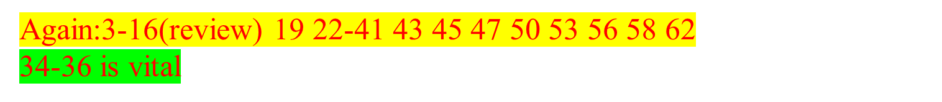
Operating Systems
Memory Management (2)
Fagui Liu
<number>/73

Slide 2
Content of the Lecture
Review
Demand paging
Page Replacement Algorithms
  Optimal -NRU -FIFO -Second-chance
  Clock -LRU -Working set -WSClock
Design Issues for paging systems
Implementation Issues
Segmentation
Summary
<number>/73

Slide 3
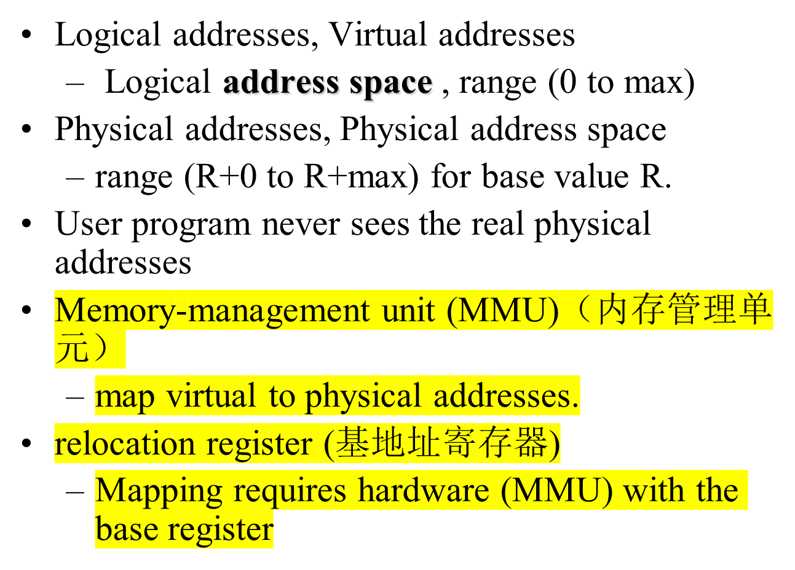
Address Space

Slide 4
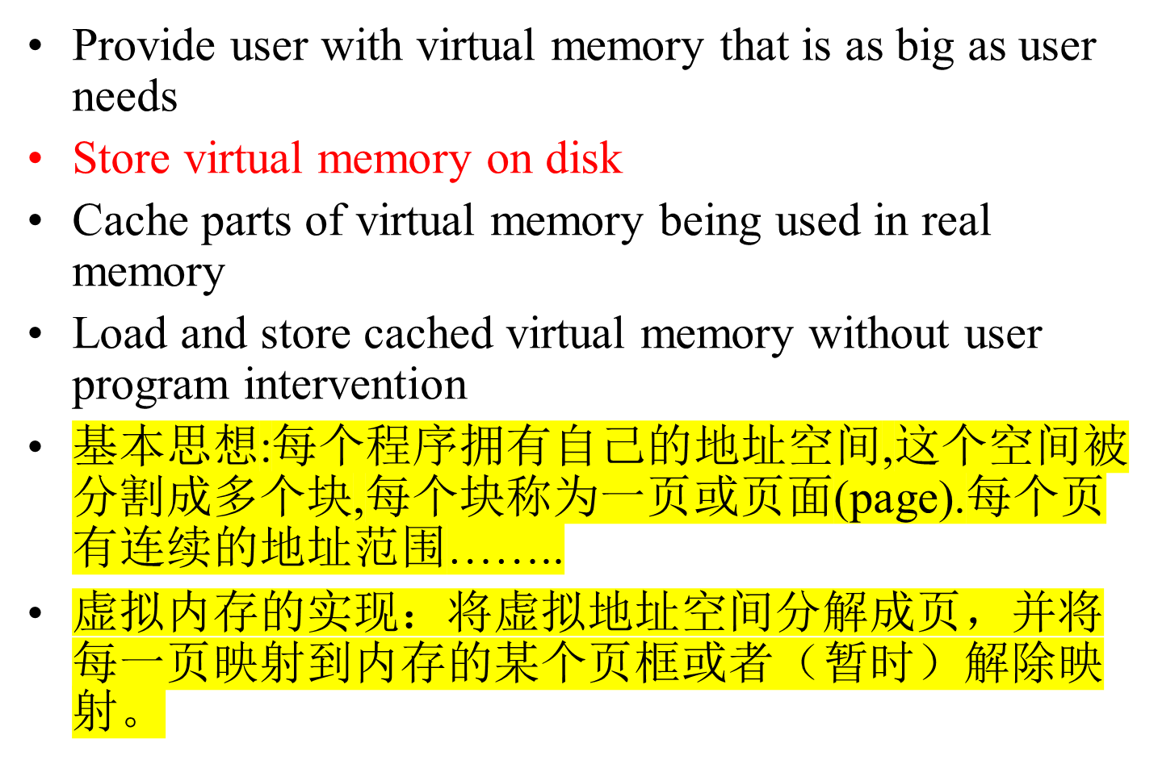
Virtual Memory

Slide 5
Structure of Page Table Entry
高速缓冲
禁止位(禁止该页面被高速缓存）
修改位（或脏位）
“在/不在”位（存在位）
页框号
保护位
访问位
Figure 3-11. A typical page table entry

Slide 6
Effective Access Time
TLB lookup time = ε time unit
Memory cycle -- m microsecond
TLB Hit ratio -- α
Effective access time
  Eat = (1m+ε)α+(2m+ε)(1-α)
  Eat = 2m+ε-α
<number>/73
Notes:
This is how much access time is sped up when memory address is derefenced to physical address using an associative register.

Slide 7
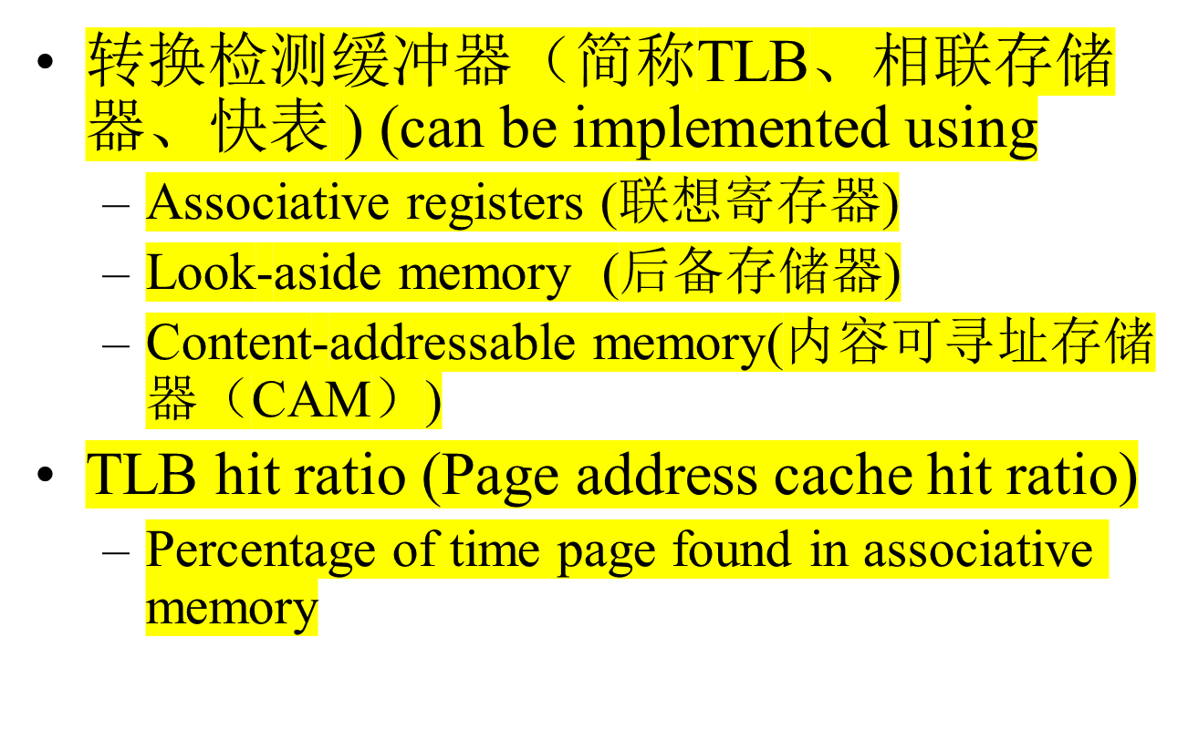
Paging Implementation Issues

Slide 8
Hardware-Controlled TLB
On a TLB miss
  Hardware loads the PTE(页表项) into the TLB
    Need to write back if there is no free entry
  Generate a fault if the page containing the PTE is invalid
  VM software performs fault handling
  Restart the CPU
On a TLB hit, hardware checks the valid bit
  If valid, pointer to page frame in memory
  If invalid, the hardware generates a page fault
    Perform page fault handling
    Restart the faulting instruction

Slide 9
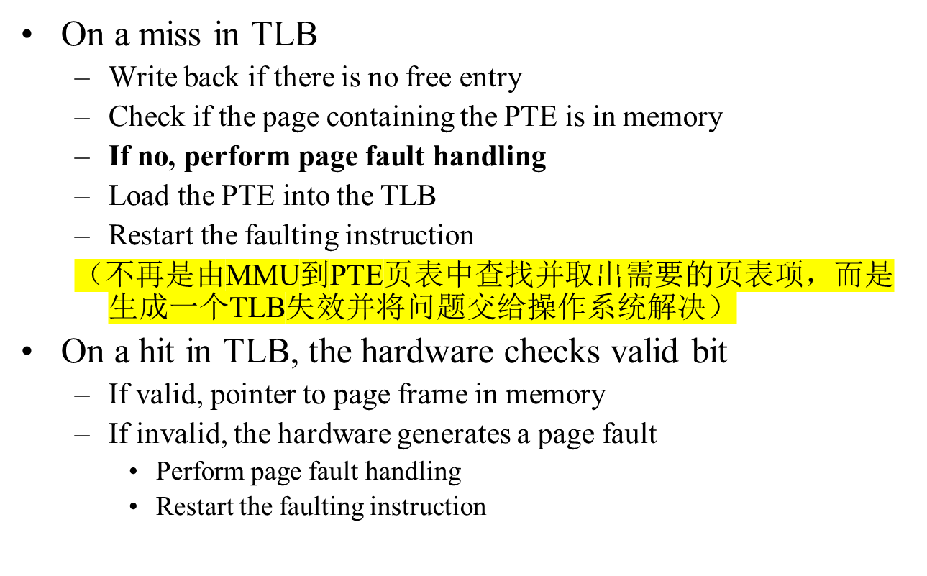
Software-Controlled TLB

Slide 10
Hardware vs. Software Controlled
Hardware approach
  Efficient
  Inflexible（不灵活）
  Need more space for page table
Software approach
  Flexible（灵活)
  Software can do mappings by hashing
    PP# → (Pid, VP#)
    (Pid, VP#) → PP#
  Can deal with large virtual address space

Slide 11
Multilevel Page Tables
Since the page table can be very large, one solution is to page the page table
Divide the page number into
  An index into a page table of second level page tables
  A page within a second level page table
<number>/73

Slide 12
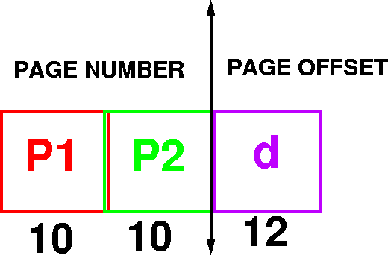
Example Addressing on a Multilevel Page Table System
A logical address (on 32 bit machine with 4k page size) is divided into
  A page number consisting of 20 bits
  A page offset consisting of 12 bits
Divide the page number into
  A 10-bit page number
  A 10-bit page offset
<number>/73

Slide 13

Multilevel Page Tables
(b)
Figure 3-13. (a) A 32-bit address with two page table fields.
(b) Two-level page tables.

Slide 14

Main idea
  One PTE for each physical page frame
  Hash (Vpage, pid) to Ppage#
Pros
  Small page table for large address space
Cons
  Lookup is difficult
  Overhead of managing hash chains, etc
Physical
address
Virtual
address
pid
vpage
offset
k
offset
0
pid
vpage
k
n-1
Inverted page table
<number>/73

Slide 15
Inverted Page Table
Virtual Address (004006)
Page Table
004
006
0
1
5
0
1
4
1
0
1
005
006
Physical Address (005006)
<number>/73

Slide 16




Page Replacement
Find location of page on disk
Find a free page frame
  If free page frame use it
  Otherwise, select a page frame using the page replacement algorithm
  Write the selected page to the disk and update any necessary tables
Read the requested page from the disk.
Restart the user process.
It is necessary to be careful of synchronization problems. For example, page faults may occur for pages being paged out.
<number>/73

Slide 17
Content of the Lecture
Review
Demand paging
Page Replacement Algorithms
  Optimal -NRU -FIFO -Second-chance
  Clock -LRU -Working set -WSClock
Design Issues for paging systems
Implementation Issues
Segmentation
Summary
<number>/73

Slide 18
Paging Policies
Fetch Strategies
  When should a page be brought into primary (main) memory from secondary (disk) storage.
Placement Strategies
  When a page is brought into primary storage, where is it to be put?
Replacement Strategies
  Which page now in primary storage is to be removed from primary storage when some other page or segment is to be brought in and there is not enough room.
<number>/73

Slide 19
Demand Paging
Algorithm Never bring a page into primary memory until its needed.
  Page fault
  Check if a valid virtual memory address. Kill job if not.
  If valid reference, check if its cached in memory already (perhaps for some other process.) If so, skip to 7).
  Find a free page frame.
  Map address into disk block and fetch disk block into page frame. Suspend user process.
  When disk read finished, add vm mapping for page frame.
  If necessary, restart process.
<number>/73

Slide 20
Issue: Eviction(逐出 ）
Hopefully, kick out a less-useful page
  Dirty pages require writing, clean pages don’t
    Hardware has a dirty bit for each page frame indicating this page has been updated or not
  Where do you write? To “swap space”
Goal: kick out the page that’s least useful
Problem: how do you determine utility?
  Heuristic（启发式）: temporal locality exists
  Kick out pages that aren’t likely to be used again
<number>/73

Slide 21
Terminology
Reference string: the memory reference sequence generated by a program.
Paging – moving pages to (from) disk
Optimal(最佳) – the best (theoretical) strategy
Eviction(逐出) – throwing something out
Pollution(污染) – bringing in useless pages/lines
<number>/73

Slide 22
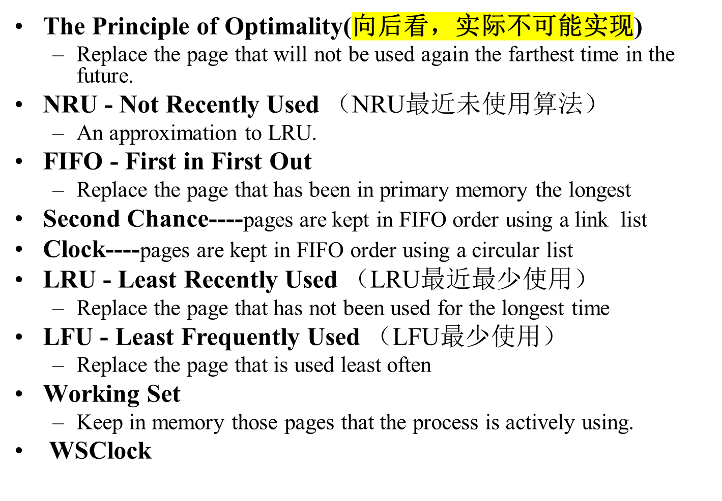
Page Replacement Strategies
<number>/73

Slide 23
Principal of Optimality （最优）
Description:
  Assume that each page can be labeled with the number of instructions that will be executed before that page is first references, i.e., we would know the future reference string for a program.
  Then the optimal page algorithm would choose the page with the highest label to be removed from the memory.
This algorithm provides a basis for comparison with other schemes.
Impractical（不现实） because it needs future references
If future references are known
  should not use demand paging
  should use pre paging to allow paging to be overlapped with computation.
<number>/73

Slide 24
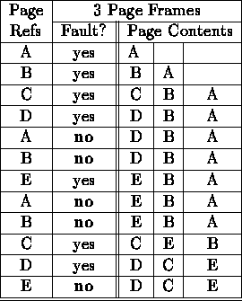
Optimal Example
12 references, 7 faults
<number>/73

Slide 25
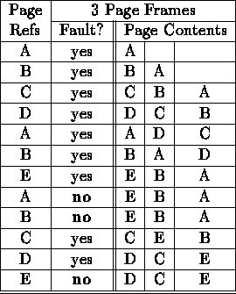
FIFO
12 references, 9 faults
<number>/73

Slide 26
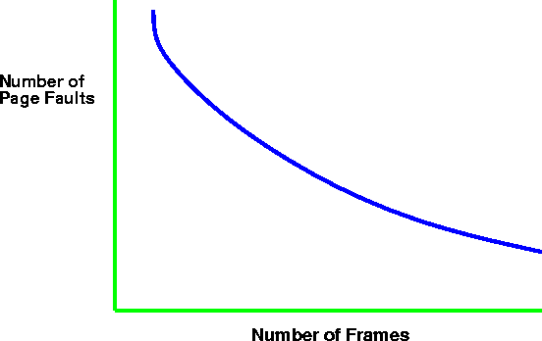
Paging Behavior with Increasing
Number of Page Frames
<number>/73

Slide 27

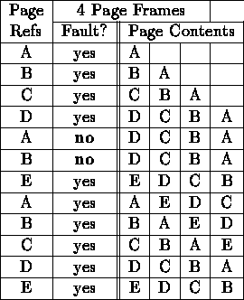
As the number of page frames increase, so does the fault rate.
12 references, 10 faults
<number>/73

Slide 28
Second Chance（可以用循环list表示）
Only one reference bit in the page table entry.
  0 initially
  1 When a page is referenced
pages are kept in FIFO order using a link list.
Choose “victim牺牲者）” to evict（逐出）
  Select head of FIFO
  If page has reference bit set, reset bit and select next page in FIFO list.
  keep processing until reach page with zero reference bit and page that one out.
system v, r4 uses a variant of second chance
<number>/73

Slide 29
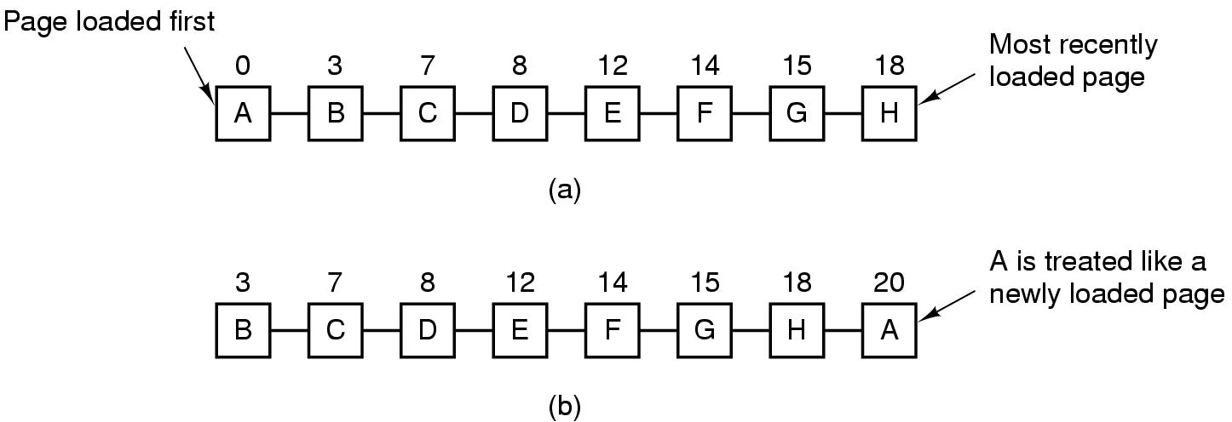
Second Chance Algorithm
Figure 3-15. Operation of second chance.
(a) Pages sorted in FIFO order.
(b) Page list if a page fault occurs at time 20 and A has its R bit set. The numbers above the pages are their load times.

Slide 30
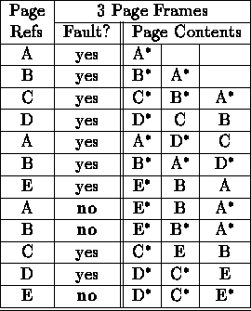
Second Chance Example
12 references, 9 faults
<number>/73

Slide 31
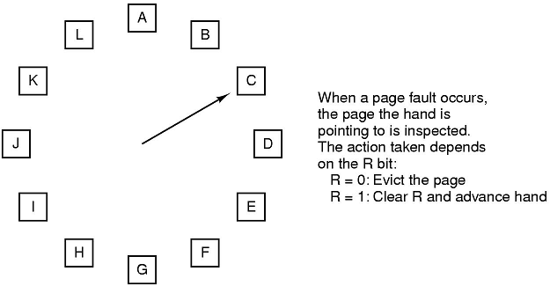
The Clock Page Replacement Algorithm
Figure 3-16. The clock page replacement algorithm.

Slide 32
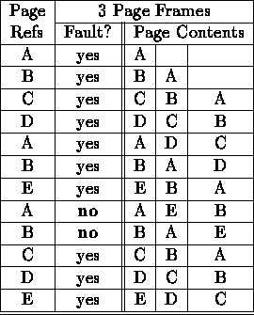
LRU
12 references, 10 faults
<number>/73

Slide 33
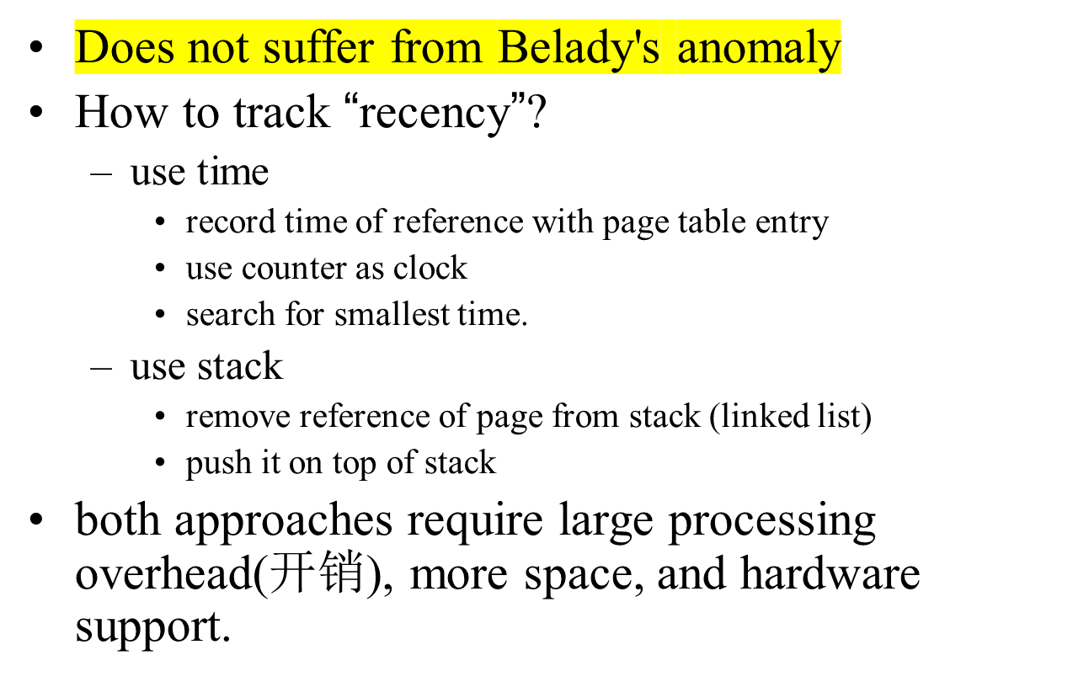
Least Recently Used Issues
<number>/73

Slide 34

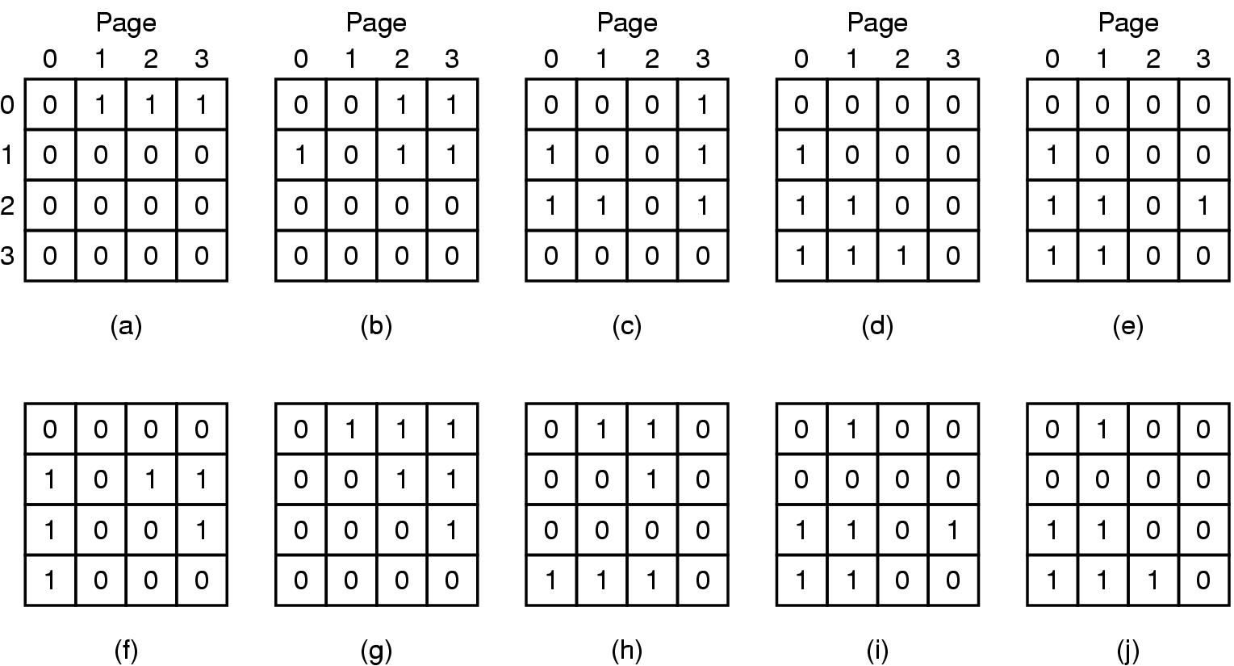
Figure 3-17. LRU using a matrix when pages are referenced in the order 0, 1, 2, 3, 2, 1, 0, 3, 2, 3.

Slide 35
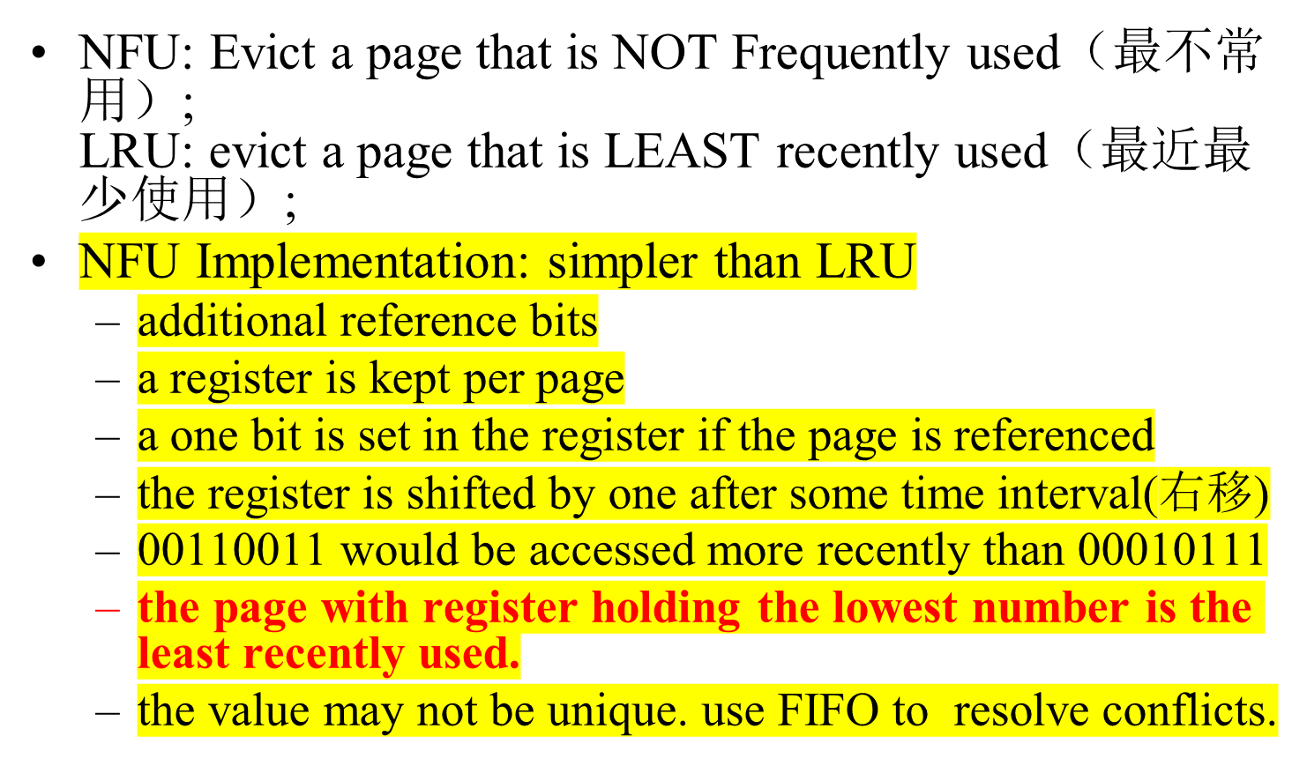
NFU: A LRU Approximation（用软件模拟）
<number>/73

Slide 36
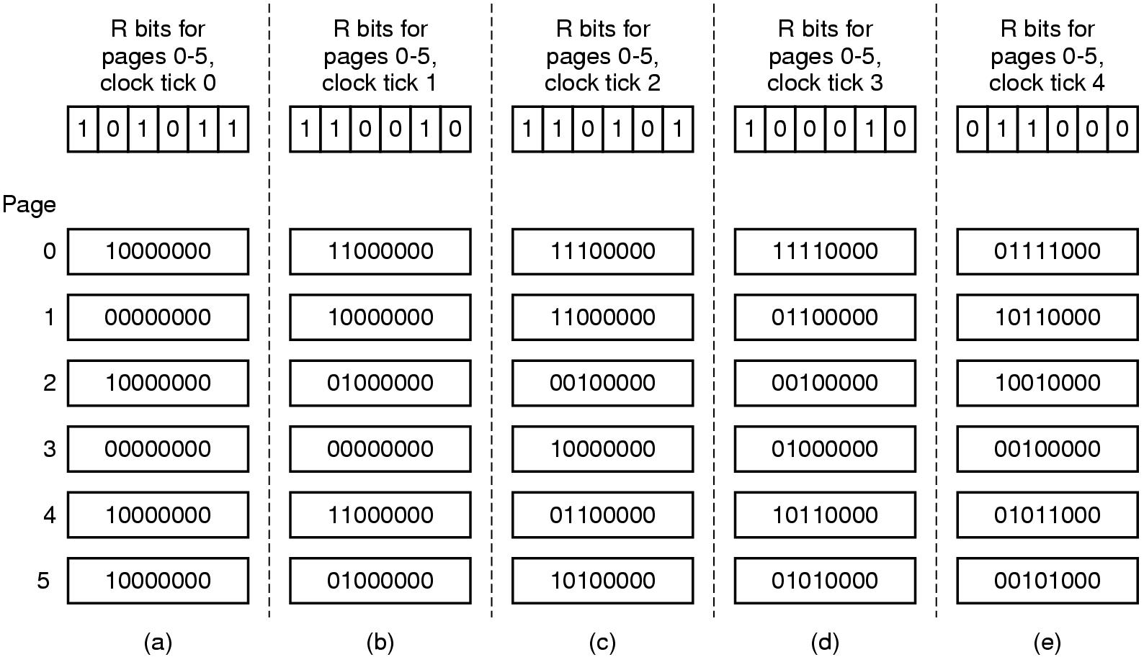
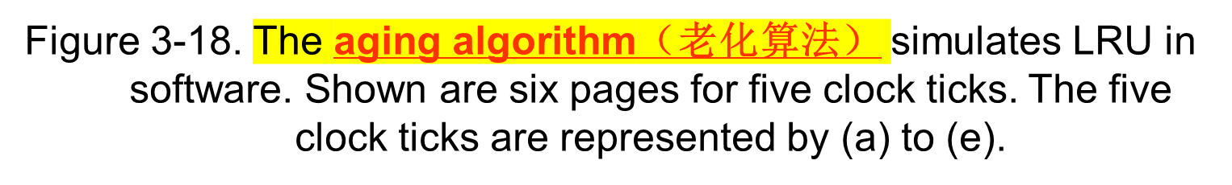
Simulating LRU in Software

Slide 37
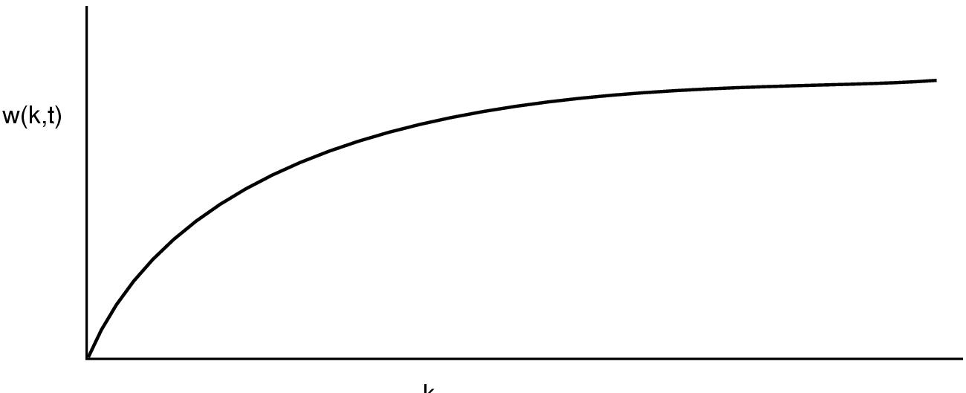
The Working Set Page Replacement Algorithm (1)
k
The working set is the set of pages used by the k most recent memory references(工作集是在最近K次内存访问所有过的页面的集合)
w(k,t) is the size of the working set at time, t(函数w(k,t) 是在时刻t 的工作集的大小)
<number>/73

Slide 38

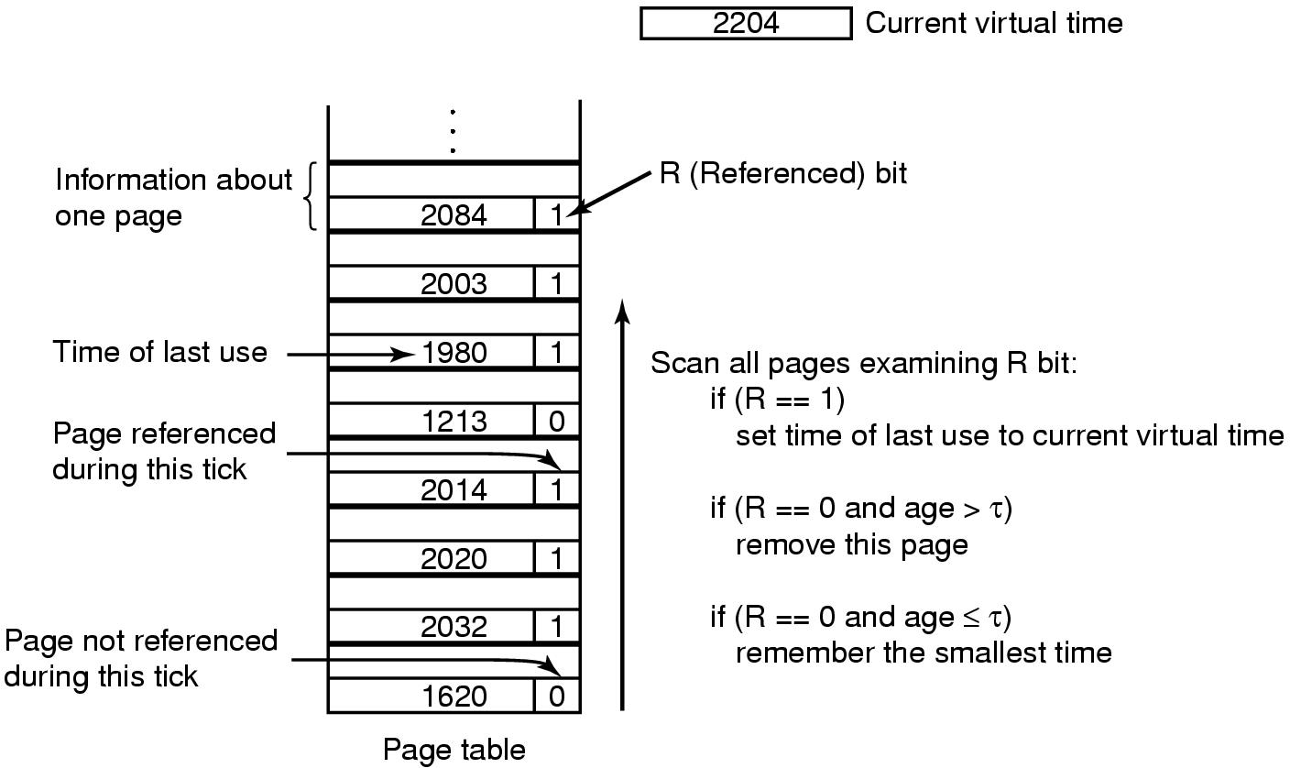

The Working Set Page Replacement Algorithm (2)
Age(生存时间)=Current virtual time(当前实际时间)-Time of last use(上次使用时间)
Smallest time(最小时间)为min {Time of last use}上次使用时间的最小值
<number>/73

Slide 39
The WSClock Page Replacement Algorithm
（工作集时钟页面置换算法）(1)
When the hand comes all the way around to its
starting point there are two cases to consider:
At least one write has been scheduled.
No writes have been scheduled.

Slide 40
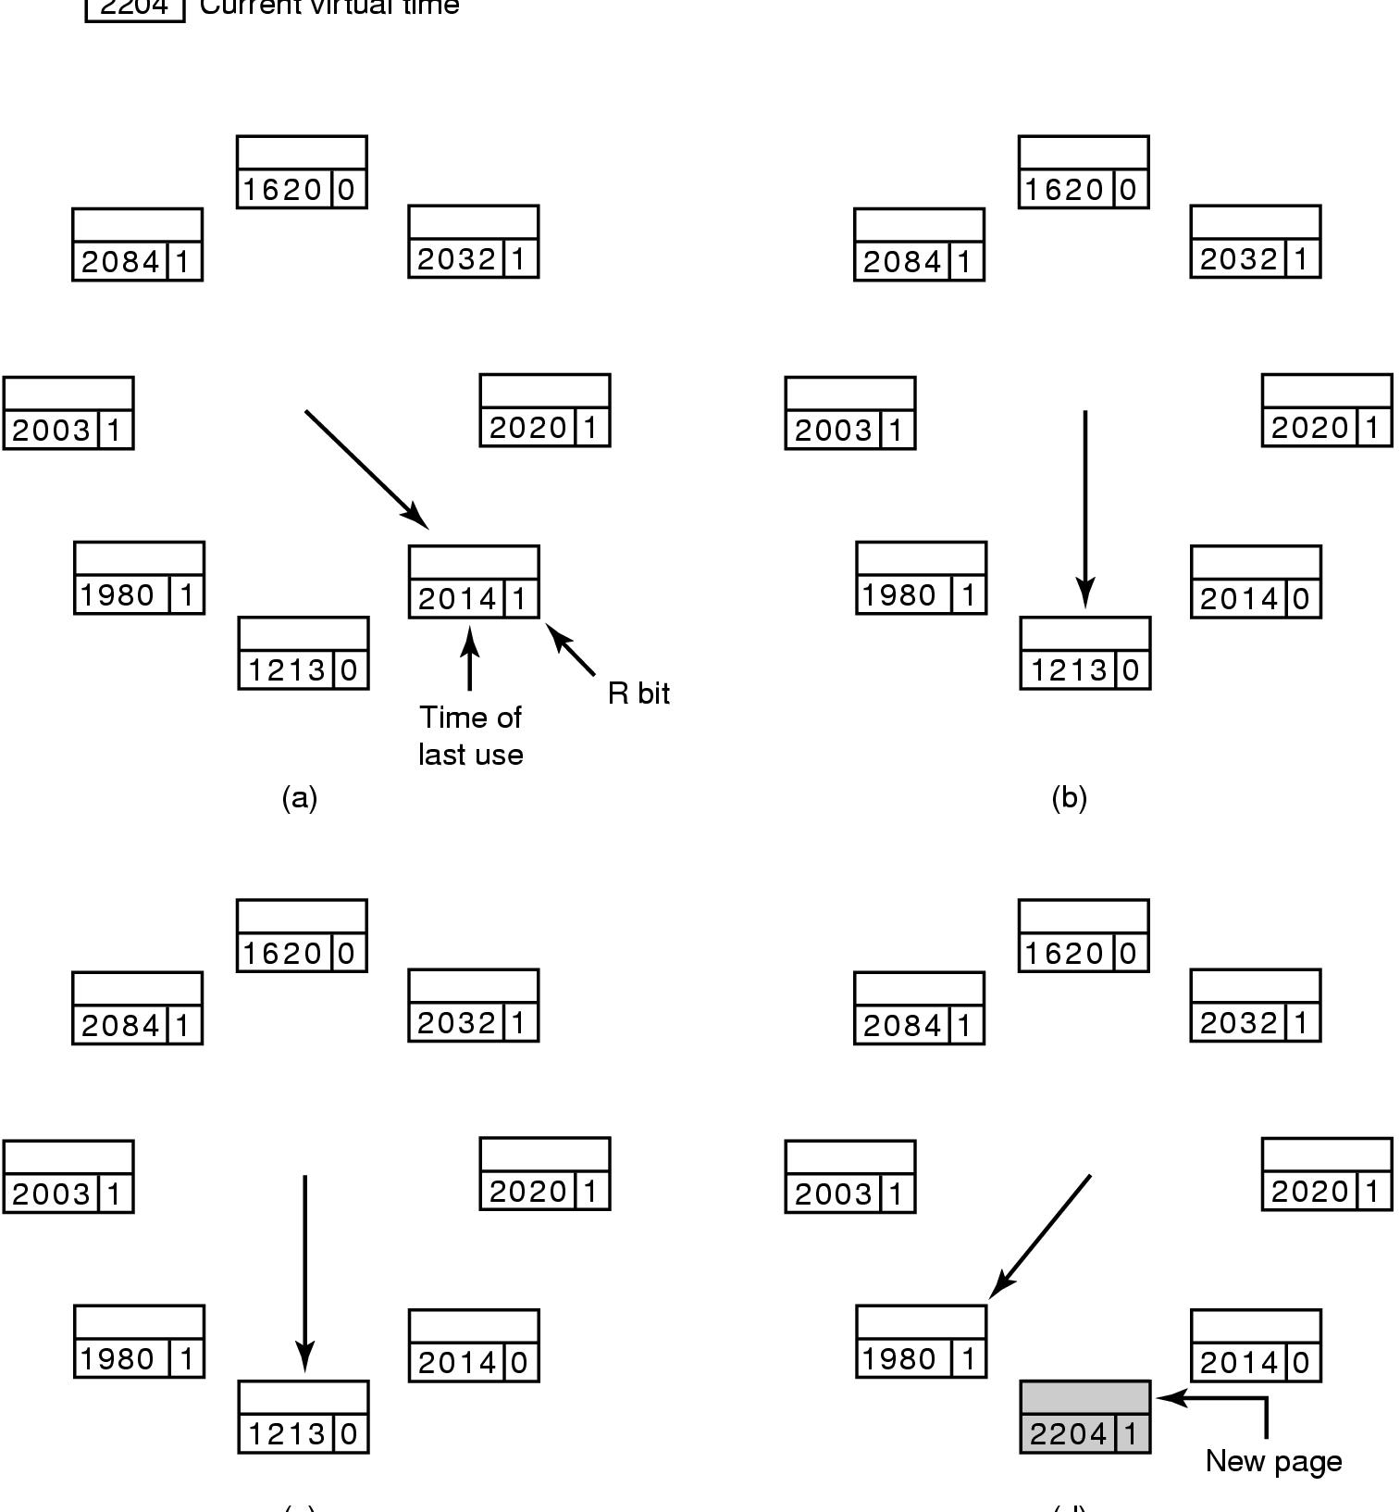
The WSClock Page Replacement Algorithm（工作集时钟页面置换算法）
Figure 3-21. Operation of the WSClock algorithm.
(c) and (d) give an example of R = 0.
<number>/73

Slide 41

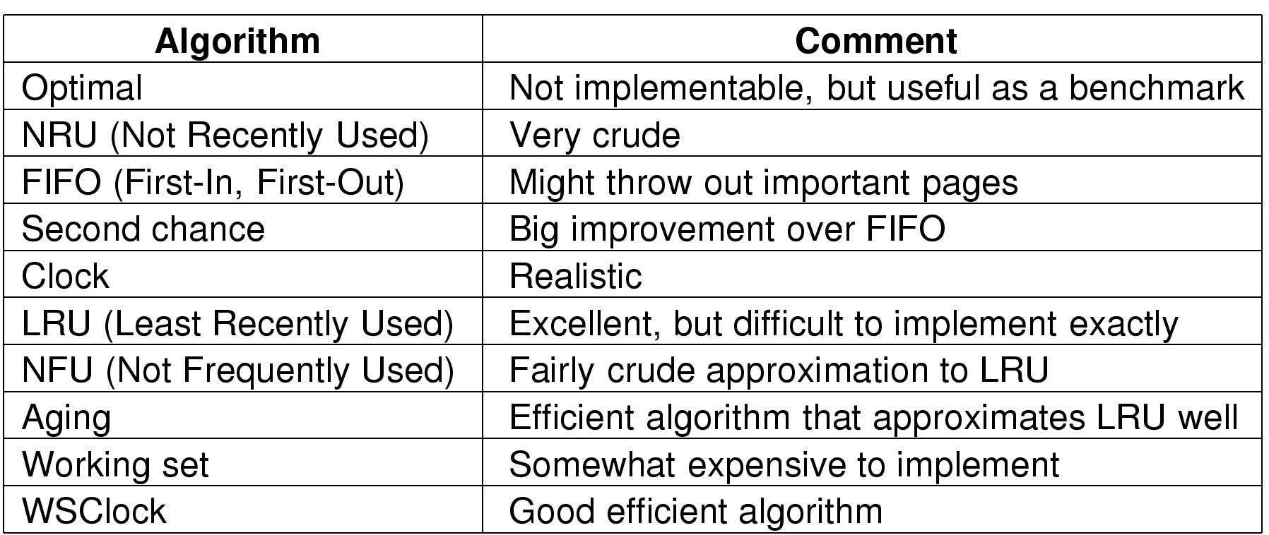
最优算法
最近未使用算法
先进先出算法
第二次机会算法
时钟算法
最近最少使用算法
最不经常使用算法
老化算法
工作集算法
工作集时钟算法
<number>/73

Slide 42
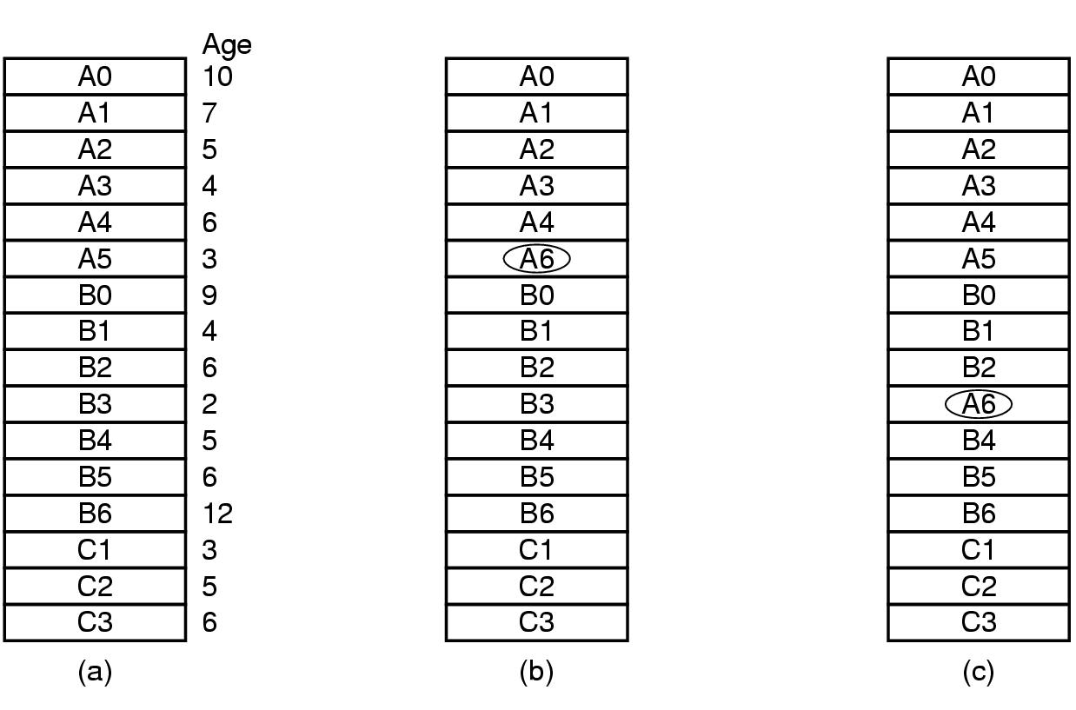
Design Issues for Paging Systems
Local versus Global Allocation Policies (1)
全局算法在通常情况下工作得比局部算法好！
(a)Original configuration：如果进程A发生缺页中断
(b)Local page replacement
(c) Global page replacement
Spring 2003
<number>/73

Slide 43
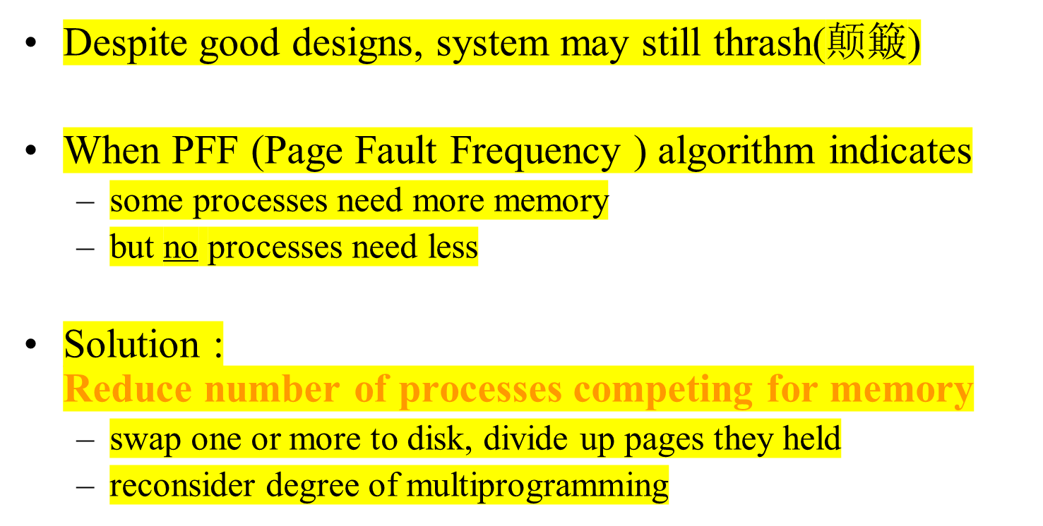
Load Control
<number>/73

Slide 44
Page Size (1)
Small page size
Advantages
  less internal fragmentation
  better fit for various data structures, code sections
  less unused program in memory
Disadvantages
  programs need many pages, larger page tables
<number>/73

Slide 45
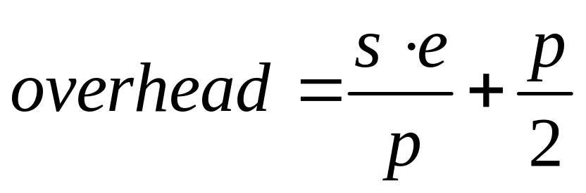
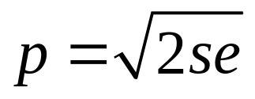
Page Size (2)
Overhead due to page table and internal fragmentation
Where
  s = average process size in bytes(进程的平均大小s字节)
  p = page size in bytes(页大小为p字节)
  e = page entry(每个页表需要e字节)
page table space
internal fragmentation
Optimized when
<number>/73

Slide 46
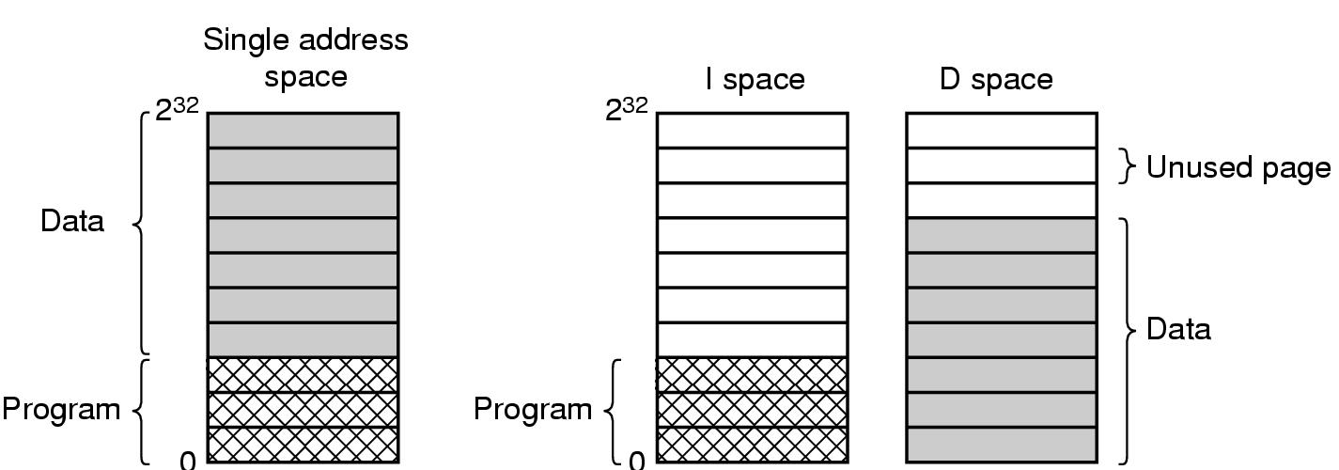
Separate Instruction and Data Spaces
Figure 3-25. (a) One address space. （如果地址空间足够大时）
(b) Separate I and D spaces(分成I空间与D空间，两种地址空间独立，都可进行分页，分别拥有自己的页表；当硬件取指令操作时，要使用I空间和I空间页表；对数据的访问通过D空间页表).

Slide 47
Sharing Pages
Code and data can be shared among processes
  mapping them into pages with common page frame mappings
Code and data must be position independent （独立）if VM mappings for the shared data are different
Code and data cannot store VM addresses for functions and variables not in shared pages
Shared code and data usually are not position independent resulting in certain regions of memory being reserved（留作） for shared libraries and the operating system
<number>/73
Notes:
A relative jump forward to a location on the same page is position independent code. So is an offset of a data byte in a data structure if the data structure can be stored on one page.
However, virtual addresses cannot be stored in a shared page if they refer to page addresses that are mapped differently in the different virtual memories that share them.

Slide 48
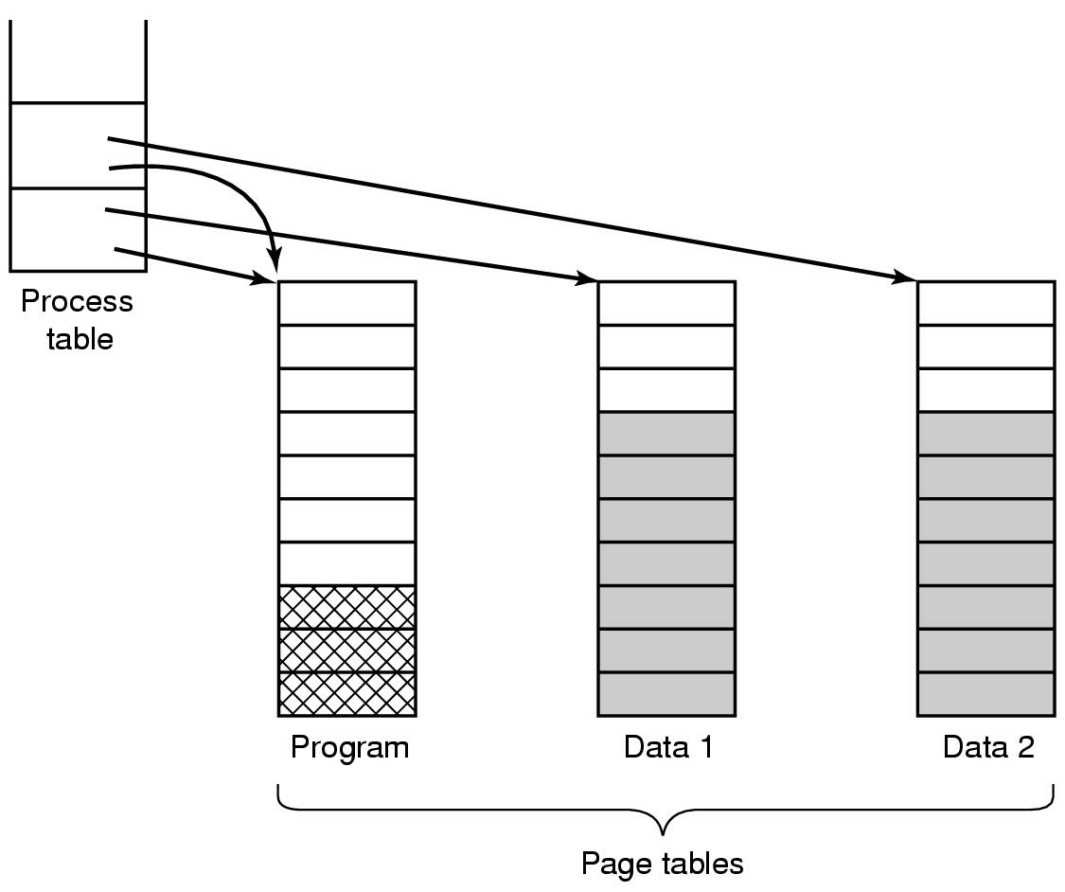
Shared Pages
Two processes sharing same program sharing its page table
（两个进程通过共享程序页表 来共享同一个程序）
<number>/73

Slide 49
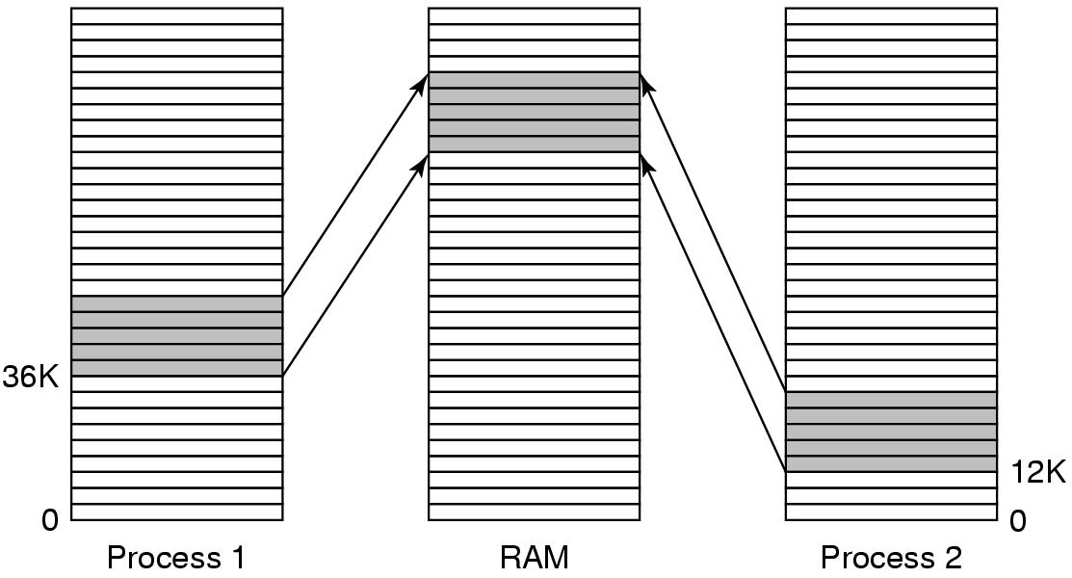
Shared Libraries
Figure 3-27. A shared library (如动态链接库DLL) being used by two processes.
当程序和共享库链接时，只加载一小段能够在运行时绑定被调用函数的存根例程（stub routine）（而非加载被调用函数）

Slide 50
Memory-mapped file(共享库实际上是一种更为通用的机制----内存映射文件的一个特例)
进程可以通过发起一个系统调用,将一个文件映射到其虚拟地址空间的一部分。
在多数实现中,在影射共享的页面时不会实际读入页面的内容,而是在访问页面时才会被每次一页地读入,磁盘文件则被当作后备存储.但进程退出或显式地解除文件映射时,所有被改动的页面会被写回文件中.
如果两个或两个以上进程同时映射了同一文件，则可以通过共享内存来通信。

Slide 51
Cleaning Policy
Need for a background process, paging daemon
  periodically inspects state of memory
When too few frames are free
  selects pages to evict using a replacement algorithm
It can use same circular list (clock)
  as regular page replacement algorithm but with diff ptr (可以采用双指针时钟:前指针指向清除(写会磁盘，后指针指向置换页面 ）
<number>/73

Slide 52
Implementation Issues—
Operating System Involvement with Paging
Four times when OS involved with paging(OS做与调页有关工作的四个时间)
Process creation
  determine program size
  create page table
Process execution
  MMU reset for new process(重置)
  TLB flushed(刷新)
Page fault time
  determine virtual address causing fault
  swap target page out, needed page in
Process termination time
  release page table, pages
<number>/73

Slide 53
Page Fault Handling
Hardware traps to kernel
General registers saved
OS determines which virtual page needed
OS checks validity of address, seeks page frame
If selected frame is dirty, write it to disk
OS brings schedules new page in from disk
Page tables updated
Faulting instruction backed up to when it began
Faulting process scheduled
Registers restored
Program continues
<number>/73

Slide 54
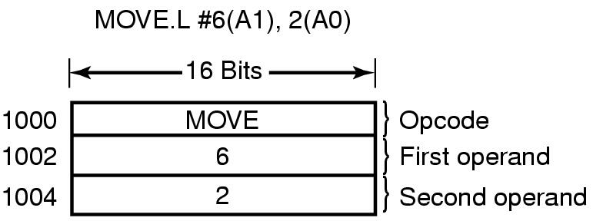
Instruction Backup
当程序访问不在内存中的页面是,将引起页面失效的指令半途停止并产生到OS的陷阱.下例从地址1000处开始的指令进行了3次内存访问，可能产生缺页中断
An instruction causing a page fault. That instruction is a example of Motorola that is used in embedded systems
CPU设计者解决方案:可用使用隐藏的内部寄存器复制程序计数器内容;
OS设计者解决方案:采用第二寄存器或找出所发生的问题来修复.
<number>/73

Slide 55
Locking Pages in Memory (pinning)
Virtual memory and I/O occasionally interact
Process issues call for read from device into buffer
  while waiting for I/O（e.g DMA）, another processes starts up
  has a page fault
  buffer for the first process may be chosen to be paged out
Need to specify some pages locked (Pinning)(或者在内核缓冲区中完成所有的I/O操作）
  exempted from being target pages
<number>/73

Slide 56

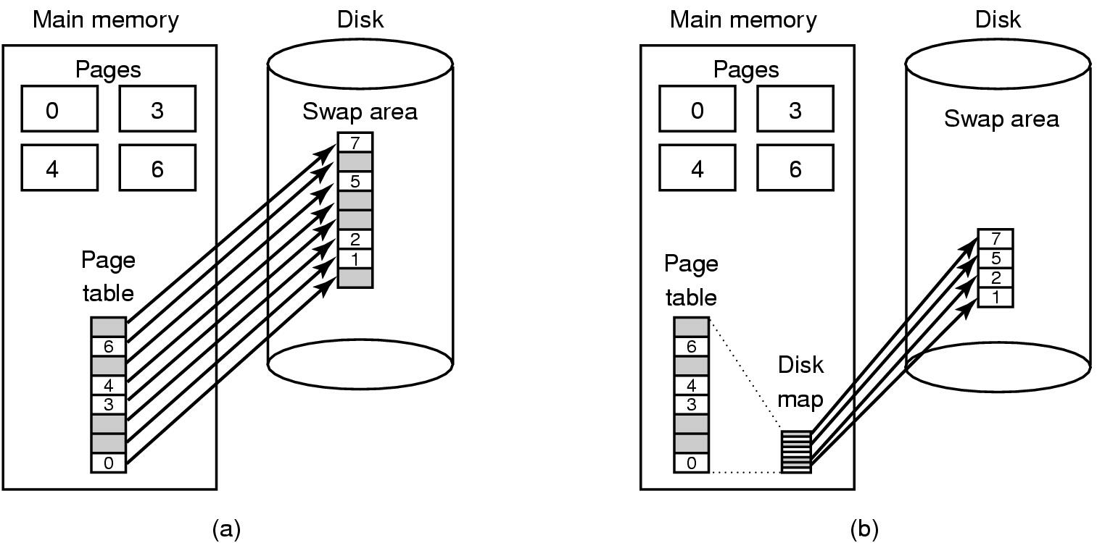
(a) Paging to static swap area(静态：页面在磁盘上有固定的位置，磁盘的交换去与进程的虚拟空间一样大)
(b) Backing up pages dynamically(动态：页面在磁盘上无固定地址)
<number>/73

Slide 57
Separation of Policy and Mechanism (1)
----控制系统复杂度的方法
Memory management system is divided into
three parts:
A low-level MMU handler.
A page fault handler that is part of the kernel.
An external pager running in user space（外部页面调度程序）.

Slide 58
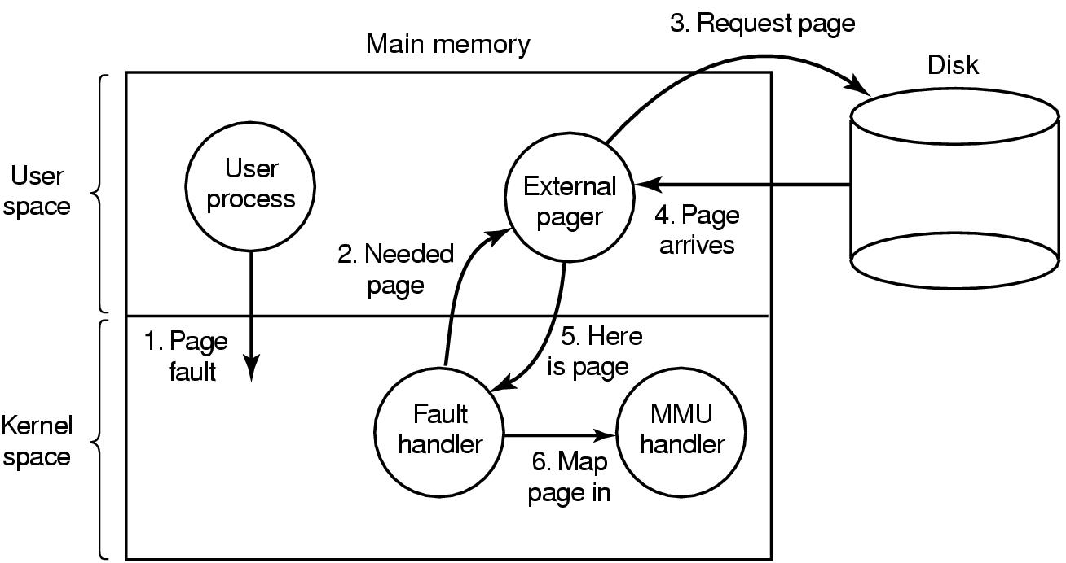
Separation of Policy and Mechanism
把策略从机制中分离出来(2)
机制
策略：Page fault handling with an external pager（调页程序）
<number>/73

Slide 59
Segmentation (1)
A compiler has many tables that are built up as compilation proceeds, possibly including(编译器在编译过程中会建立许多表,其中可能的的表格有):
The source text being saved for the printed listing (on batch systems).
The symbol table – the names and attributes of variables.
The table containing integer, floating-point constants used.
The parse tree(语法分析树), the syntactic analysis of the program.
The stack used for procedure calls within the compiler.
前4个表随着编译的进行不断增长，第5个表在编译过程中以一种不可预测的方式增长或缩小。

Slide 60

Segmentation (2)
One-dimensional address space with growing tables
One table may bump into another
<number>/73

Slide 61
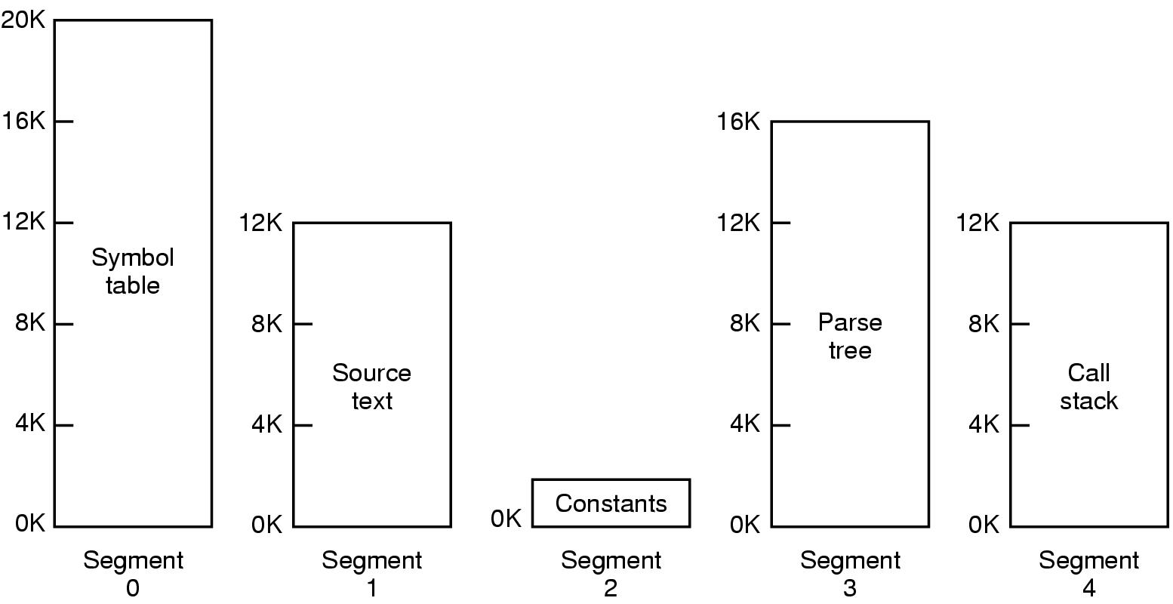
Segmentation (3)
Allows each table to grow or shrink, independently
<number>/73

Slide 62



<number>/73
Notes:
Fluctuate-变动, 波动, 涨落, 上下, 动摇
vt.使动摇, 使波动, 使起伏
accommodate
[ E5kCmEdeit ]
vt.供应, 供给, 使适应, 调节, 和解, 向...提供, 容纳, 调和
vi.适应

Slide 63
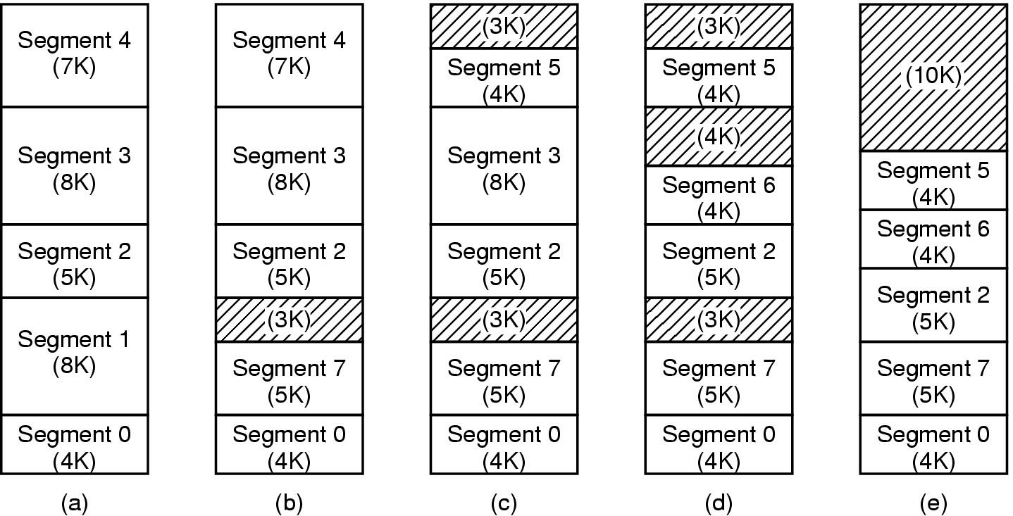
Implementation of Pure Segmentation
(a)-(d) Development of checkerboarding
(e) Removal of the checkerboarding by compaction
<number>/73
Notes:
SEG1out ,seg7 in

Slide 64
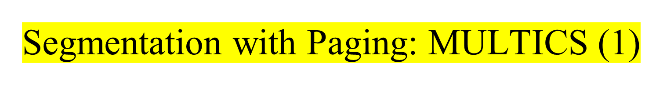
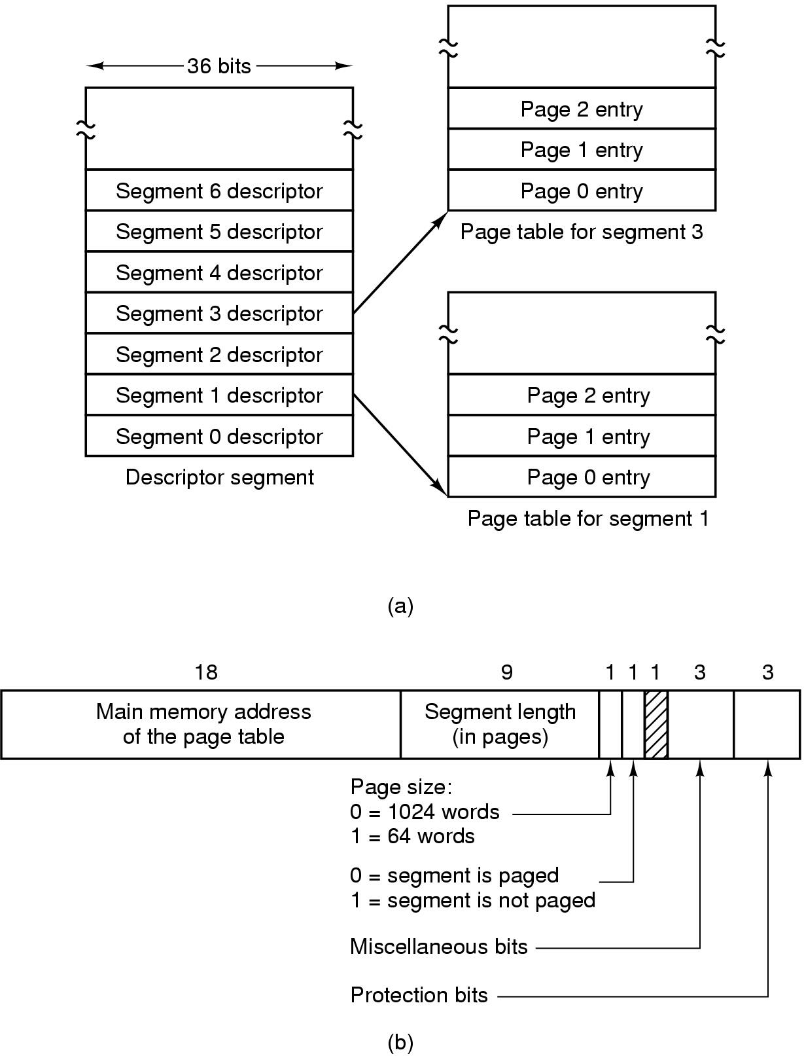
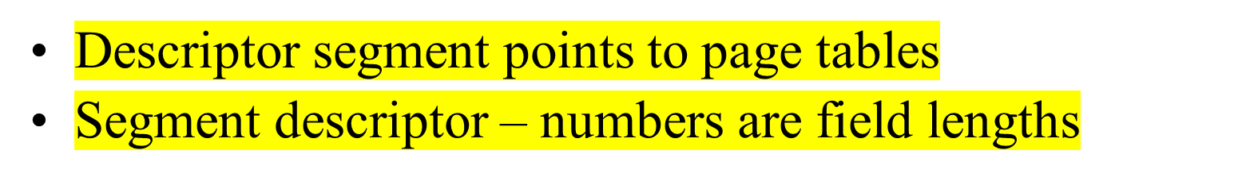


Slide 65

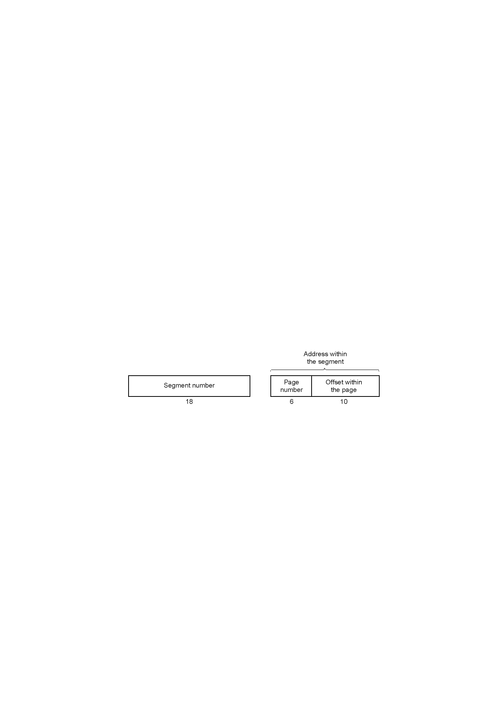
A 34-bit MULTICS virtual address
<number>/73

Slide 66
Segmentation with Paging: MULTICS (6)
When a memory reference occurs, the following algorithm is carried out:
The segment number used to find segment descriptor.
Check is made to see if the segment’s page table is in memory.
  If not, segment fault occurs.
  If there is a protection violation, a fault (trap) occurs.
Page table entry for the requested virtual page examined.
  If the page itself is not in memory, a page fault is triggered.
  If it is in memory, the main memory address of the start of the page is extracted from the page table entry
The offset is added to the page origin to give the main memory address where the word is located.
The read or store finally takes place.

Slide 67
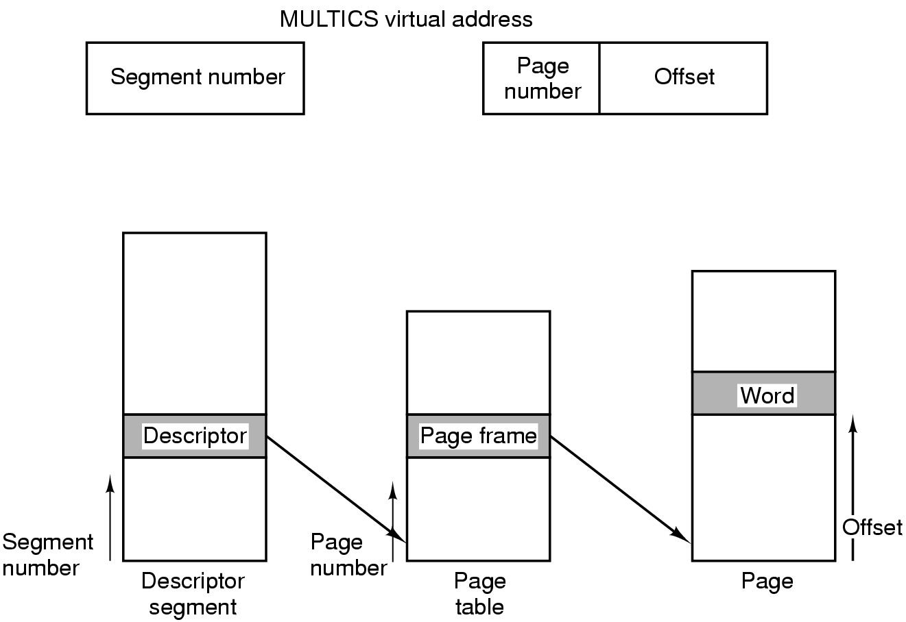
Segmentation with Paging: MULTICS (3)
Conversion of a 2-part MULTICS address into a main memory address
<number>/73

Slide 68
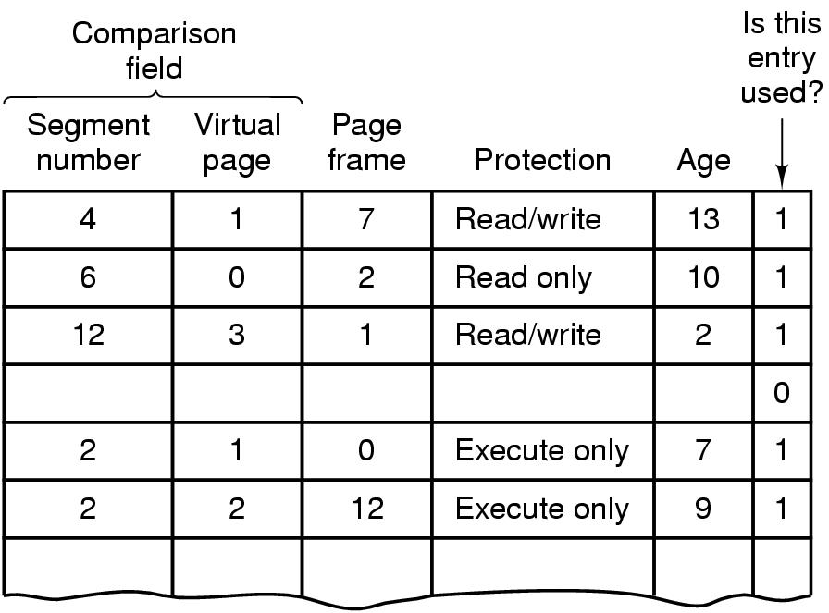
Segmentation with Paging: MULTICS (4)
Simplified version of the MULTICS TLB
Existence of 2 page sizes makes actual TLB more complicated
<number>/73
Notes:
页面大小有1024字节和64字两种.

Slide 69
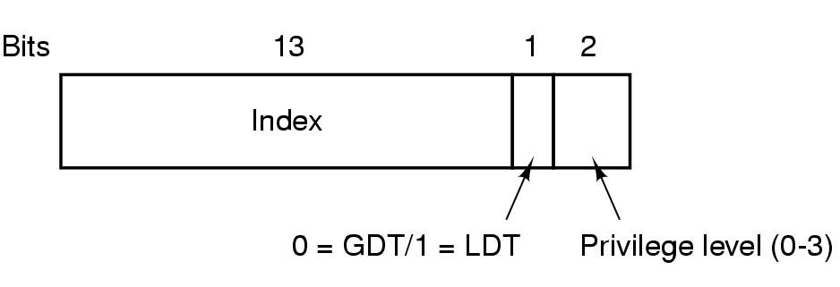
Segmentation with Paging: Pentium (1)
A Pentium selector
GDT( Global Descriptor Table), LDT (Local Descriptor Table)
I 表示段在局部的,在LDT中
<number>/73

Slide 70
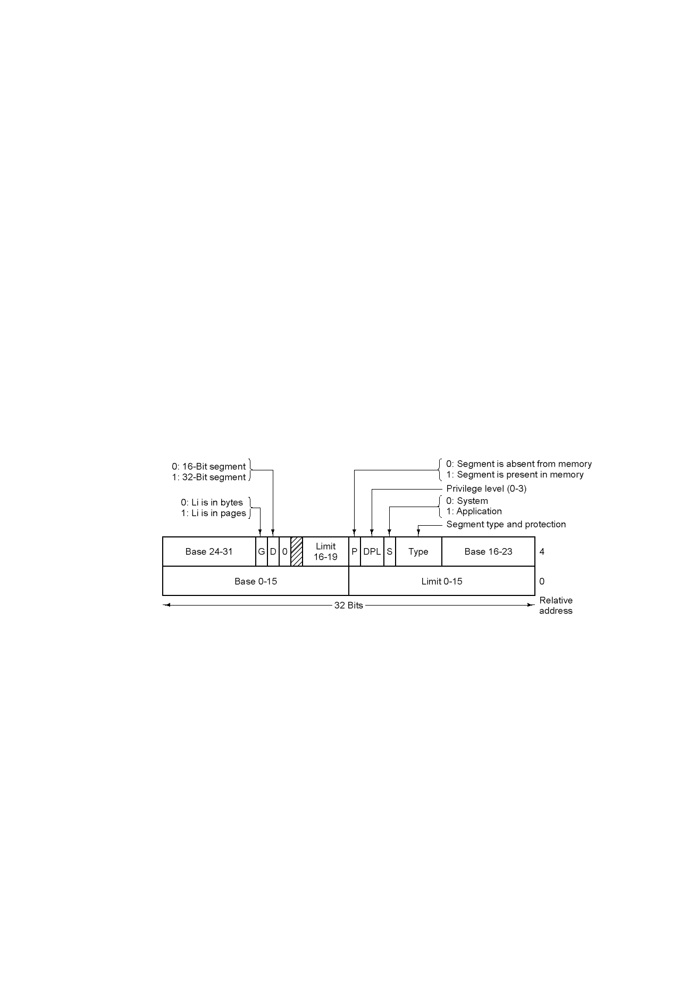
Segmentation with Paging: Pentium (2)
Pentium code segment descriptor
Data segments differ slightly
<number>/73

Slide 71
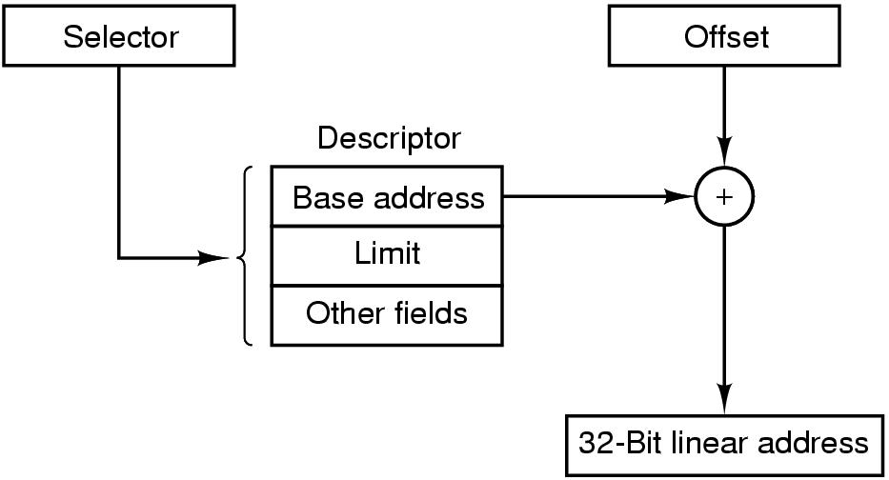
Segmentation with Paging: Pentium (3)
Conversion of a (selector, offset) pair to a linear address
Spring 2003
<number>/73

Slide 72
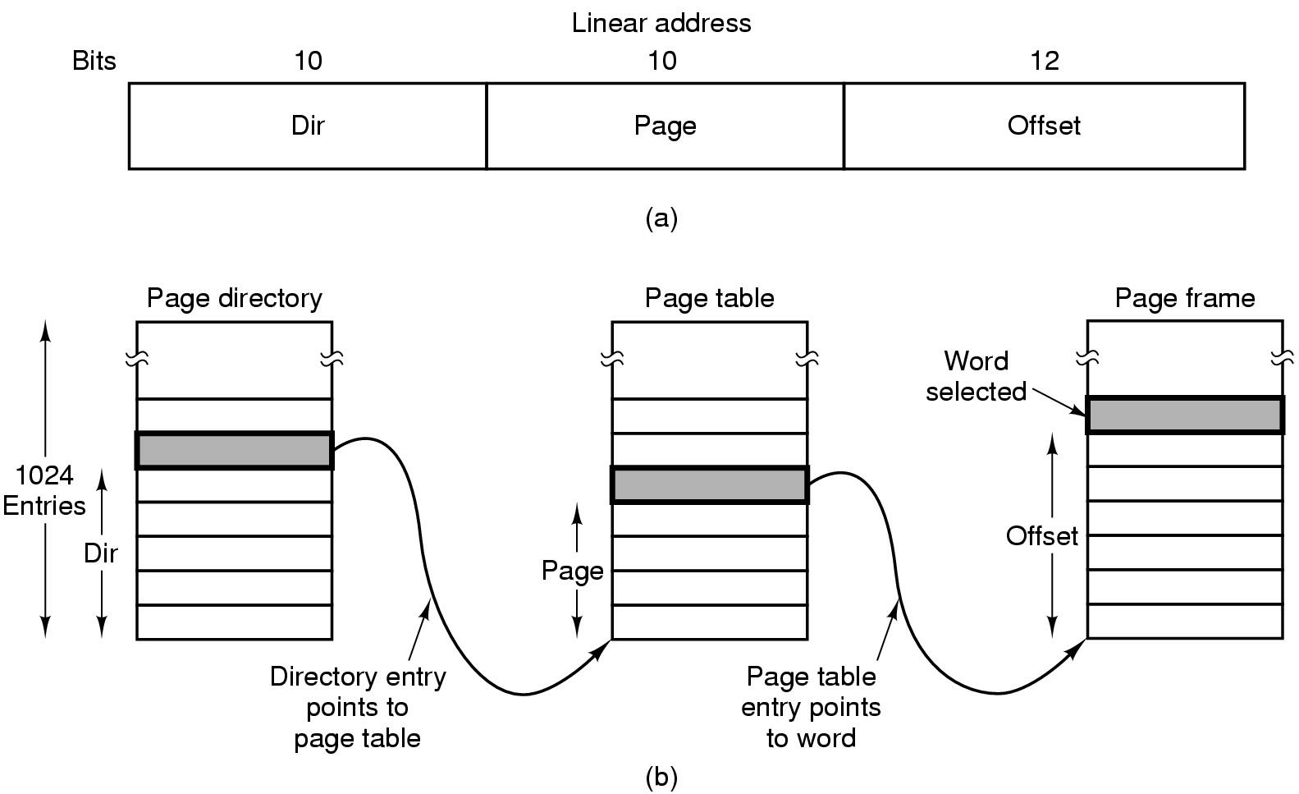
Segmentation with Paging: Pentium (4)
Mapping of a linear address onto a physical address
<number>/73

Slide 73
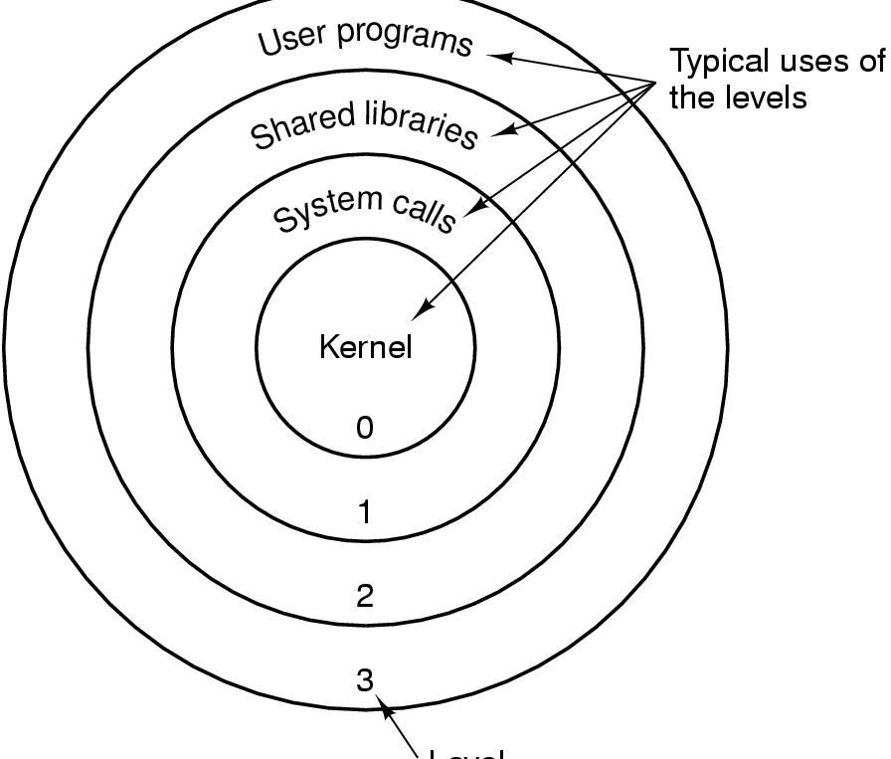
Segmentation with Paging: Pentium (5)
Level
Protection on the Pentium
<number>/73

Slide 74
Summary
Review
Demand paging
Page Replacement Algorithms
  Optimal -NRU -FIFO -Second-chance
  Clock -LRU -Working set -WSClock
Design Issues for paging systems
Implementation Issues
Segmentation
P142-145: 3,4,22，24，25，28，30，35，36，41，47
<number>/73

